Slide 1

Products
& Services Overview

Slide 2
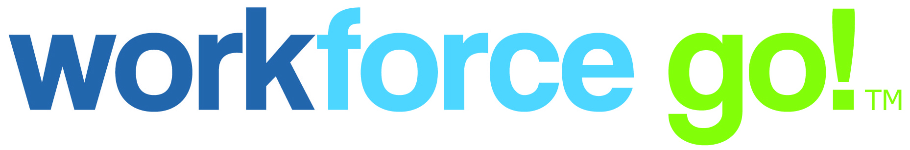
About Workforce Go!
Think of us as the experts who can help you get payroll, people, and time done right. We provide a portfolio of cloud-based and on premise human capital management (HCM) solutions that integrate with Sage ERP and other accounting systems.
Let us be your attentive partner. We will take the time to find out what makes your organization and people tick and truly listen. With an unwavering passion for customer success, our team is dedicated to standing by your side every step of the way. We look forward to streamlining processes for those businesses with the most complex needs. When you turn to us, we’ll make it all seem simple.

Slide 3
Reasons to choose Workforce Go! HCM
Unified Platform
Recruiting, HR, timekeeping, scheduling, payroll, and more
Single employee record
Single login access to system capabilities
Common user interface, database, workflow, reporting engine, and security
Single version of Truth
Single-source access to all employee data
Eliminate error-prone duplicate data entry, data inconsistency, and risk of noncompliance
Reduce reporting complexities
View key data in real time with configurable dashboards
Engaged Workforce
Streamline HR administration and simplify compliance so you focus on people, not processes
Address the needs of your entire workforce
Enforce policies accurately and consistently
Empower employees with self-service tools

Slide 4









Compensation
Performance
Time & Attendance
Benefits
Scheduling
Human Capital Management
Human
Resources
ATTRACT AND RETAIN TALENT
ENGAGE YOUR WORKFORCE
MANAGE EMPLOYEE LIFECYCLE
Leave
Recruiting
Payroll
Workforce Go! Human Capital Management (HCM) Solution:
One Unified Platform for the Entire Workforce
Notes:
Our platform consists of a full-suite HCM cloud solution delivering end-to-end employee lifecycle management for the entire workforce, who can be a mix of hourly, salary, multigenerational, geographically dispersed, multicultural, and mobile. Its comprehensive toolset integrates HR, time and attendance, payroll, scheduling, and more for managing and nurturing an organization’s most valuable asset from pre-hire to retire — giving managers single-source access to real-time employee data for driving productivity, increasing employee engagement, and making more informed business decisions.

Slide 5
We’ve got all your HCM complexities handled
Human Capital Management
Human Resource Management
Workforce
Management
Payroll
Management
Core HR management
Benefits administration
Recruitment/talent acquisition
Onboarding
Performance management
Compensation management
Time and attendance
Scheduling
Accruals tracking
Leave/absence management
ACA management & reporting
Attestation management
Data collection
Gross-to-net calculations
Tax filing/payment services
Check printing/distribution & direct deposits
Year-end processing
General ledger (GL) processing
User interface  Database  Workflow  Reporting  Employee/Manager self-service  Mobile app  Security
Notes:
HR Management - With the challenges today in attracting and retaining a steady pool of quality talent, HR professionals need an integrated set of tools for managing and nurturing their organization’s most valuable asset from pre-hire to retire. From recruiting, hiring, and onboarding to benefits, compensation, and performance management, our HR solution provides an easy-to-use, end-to-end HR solution with a centralized source for all employee in formation.
Workforce Management - When it comes to workforce management, disparate systems, manual or semi-automated processes, and limited visibility into employee data can stand in the way of having a high-performing and engaged workforce. With our solution, organizations have a unified platform that streamlines and automates the processes associated with managing a diverse workforce while controlling labor costs and reducing compliance risk.
Payroll Management – Payroll is more than just creating a paycheck on payday. Managing payroll requires an integrated set of automated tools to streamline payroll processing and ease the administrative burden placed on the payroll administrator. With our HCM solution, organizations can automate and streamline the entire payroll process and greatly reduce payroll processing time with configurable checklists and immediate access to reports and data. Starting with employee benefit deductions updated in payroll and accurate time data, organizations can ensure they are receiving the perfect paycheck and reduce compliance risk.

Slide 6
Technology and Service: the Best of Both Worlds
Purpose-Built Kronos
HCM Solution
  Expert Consultative
  Service
Workforce Go!
True unified platform
End-to-end employee lifecycle management
Single-source access to real-time data anytime, anywhere
Flexible solution that grows with your organization
Easy mobile access on the go
One-on-one client training and local support
Experienced service professionals who understand your business inside and out
HCM complexities handled by experts
Personal touch: customer service reps know your name
Through our partnership with leading HCM technology vendor Kronos, Inc., + our hand-picked staff, you can have all the tech without sacrificing on service.
Receive both a best-in-class solution and personalized support from a local provider.
Notes:
DoD compliant data security
Backed by a billion dollar company
R&D

Slide 7
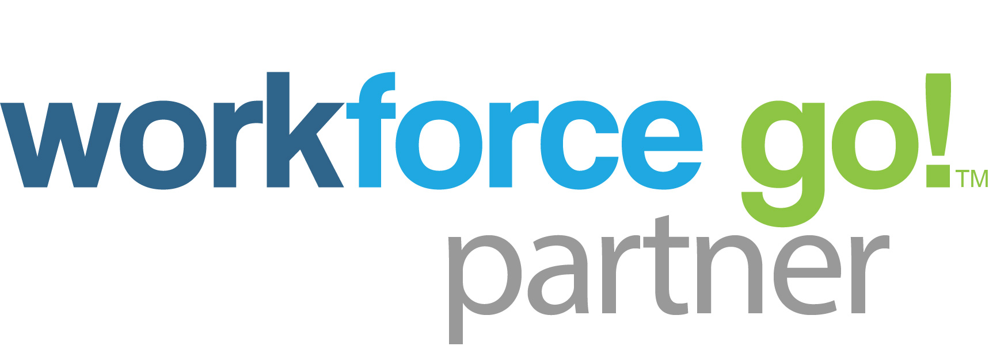
Workforce Go! Overview_PP-Pres-2018-01.ppt

